Slide 1
IoMT: Internet of Medical Things
Team AJAS (39)
Aakarsh Mishra
Joshua Koilpillai
Aayush Khatanhar
Saharsh Kallu

Slide 2
Project Objective
Nurses/doctors cannot observe every patient 24×7.
This can lead to delayed detection of critical health issues.
We aim to create an edge device with relevant sensors and a multimodal AI dashboard, to detect abnormalities and instantly alert medical staff
AIG Hospitals Hyderabad:
yearly review showed 72 post-surgery patients’ conditions deteriorated due to insufficient monitoring
This system can reduce preventable complications and even save lives.
2 cases resulted in fatalities.

Slide 3
Broad Project Overview
ECG
ESP32-CAM
accelerometer
Sensors:
project DB
Fall detection
Arrhythmia model
Gesture model
EHR-based model
AI models:
online DB

Slide 4
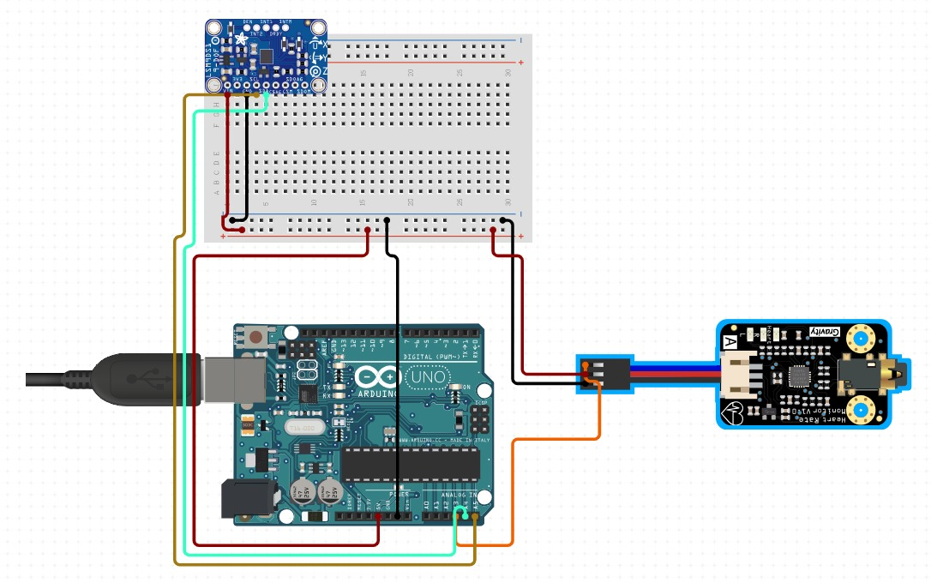
Circuit Diagram

Slide 5
Project DB
Sensors → MQTT Publish → Broker → Subscriber Node → InfluxDB → Dashboard + AI Model
MQTT Server:
We use an mqtt server to collect and publish data from our sensors running on Arduino code. The data is published to a single topic in a format similar to JSON.
Telegraf (Subscriber Node):
Telegraf is a subscriber application that collects the data from our mqtt server by subscribing to the topic given to it, formats it, and writes the data into our InfluxDB database.
InfluxDB:
InfluxDB is our database for storing data in an easily processible and viewable manner, and makes the data available to our dashboard and training/processing for our AI models.

Slide 6
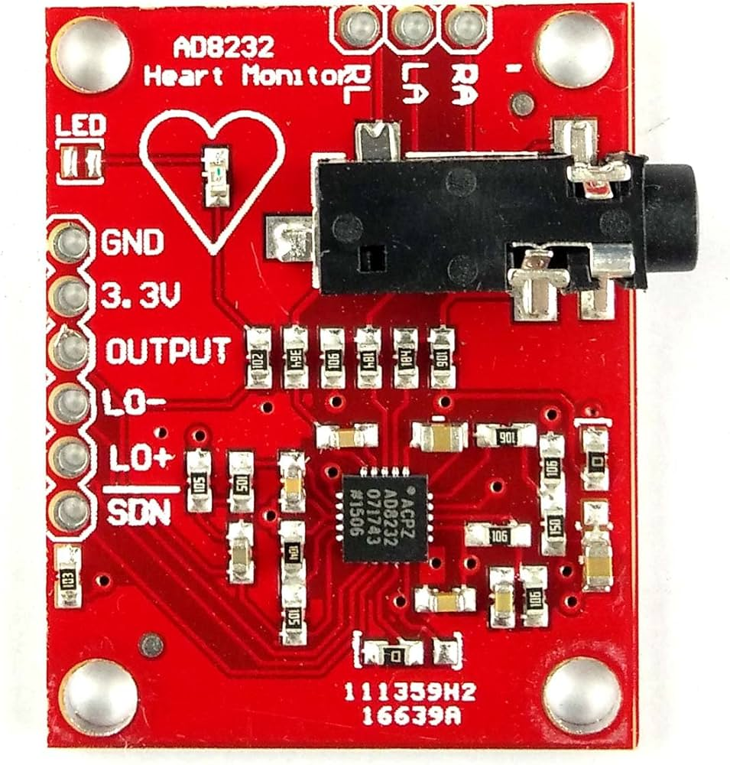
AD8232 ECG
Purpose:
Measures electrical activity of the heart to heart-rhythm analysis and detect arrhythmias.
Advantages:
  Enables heart rate calculation for further inferences
  Low-power, compact, wearable-friendly
  Easy to interface with ESP32-based system
Working/Output:
  Works by capturing voltage differences using 3 electrodes
  Requires stickers for accurate data collection
  Outputs a clean analogue ECG waveform (RAW values)

Slide 7
Arrhythmia model: ECG
The model is a 3D-CNN with conv1D layers(32->64->128)filters with batch normalization and dropout.
Total of 140k+ parameters.
The model takes in sensor data from our medical bracelet and uses it to predict with ~90% accuracy whether or not a patient has arrhythmia
Training:
  Class-balanced weighting for imbalance data and early stopping if validation AUC does not improves for consecutively 3 epochs.
  70/15/15 train/val/test split.
  The model was trained on data collected from online samples plus a mix of our own data.
  At epoch 1 we had ~70% val_auc and by the final epoch we had ~90%val_auc and the testing data gave auc of 93%

Slide 8
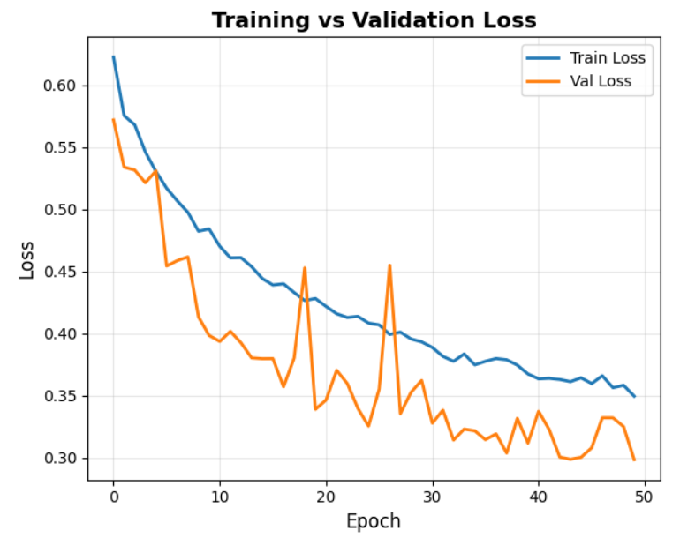
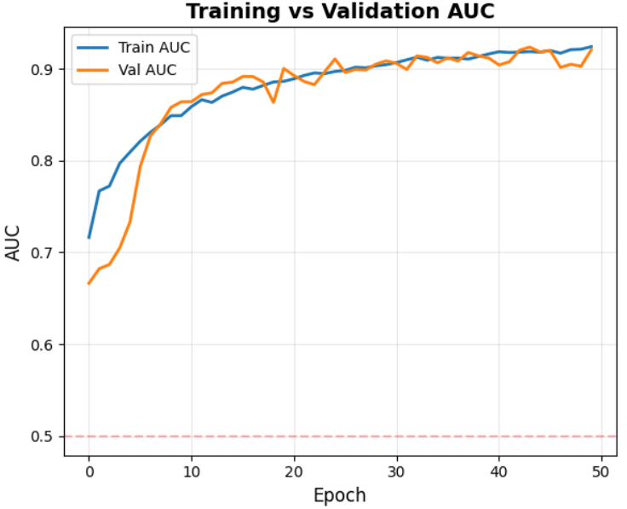

Slide 9
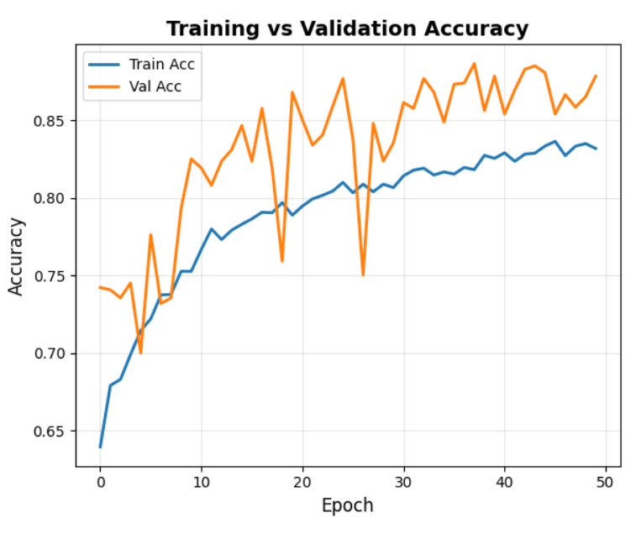
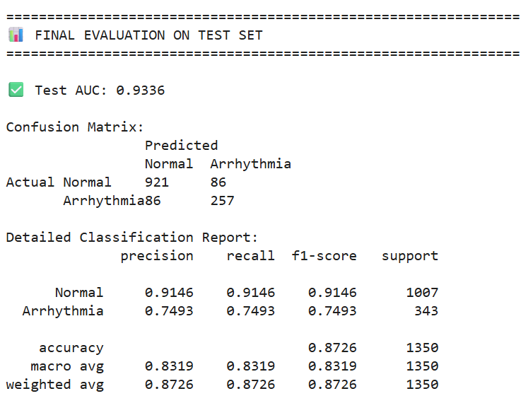

Slide 10
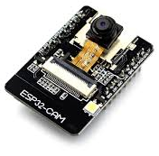
ESP32 CAM
Purpose:
Captures real-time images/video frames to classify patient hand gestures for communication and assistance signaling.
Advantages:
  Built-in camera + Wi-Fi for edge inference and remote visibility
  Low-cost, compact, and easily mountable near patient bed
Working/Output:
  Continuously captures image frames and sends them for gesture classification
  Can detect hand gestures (e.g., help/attention signals) without physical buttons
  Outputs gesture class labels or recognition events for monitoring/alerting

Slide 11
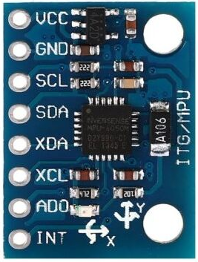
MPU6050 Accelerometer
Purpose:
Monitors patient movement, orientation, and acceleration to detect fall events or sudden abnormal posture changes.
Advantages:
Combines accelerometer + gyroscope in a single chip
High-sampling, low-power motion sensing suited for wearables
Good noise performance and easy integration with ESP32
Working/Output:
Continuously measures linear acceleration and angular velocity
Detects rapid spikes, impact patterns, or unusual tilt angles
Outputs motion readings which are analyzed to trigger fall alerts

Slide 12
EHR-based AI
We built a multi-task neural network that analyzes over 130 patient features (vitals, labs, and history) to predict 51 different conditions across 3 timeframes (6h, 24h, 48h), for a total of 153 risk scores.
Data Source: We processed 10 million+ individual records from raw patient files (FHIR JSONs), which included demographics, lab results, medications, and diagnoses.
Training:
      Parse & Clean: We used parallel processing to read millions of raw JSON files, extract the 130+ key features, and save them as clean, efficient Parquet files.
  Engineer Features: We read the clean data in chunks and engineered new features, such as 3-hour rolling averages, delta_ values (changes over time), and the 153 "risk" labels (e.g., risk_sepsis_6h).
  Train the Model: We fed this final data into our neural network to train it.
Our model is a Multi-Task Network.
The Shared Body: This is a set of deep layers (Dense(64) -> Dense(32)) that learns the complex, general patterns of "sickness" from all 131 inputs.
The Output Heads: We have 153 tiny, separate output layers (one for each risk). Each head looks at the shared body's analysis and makes a simple "yes/no" decision for its one specific condition.

Slide 13
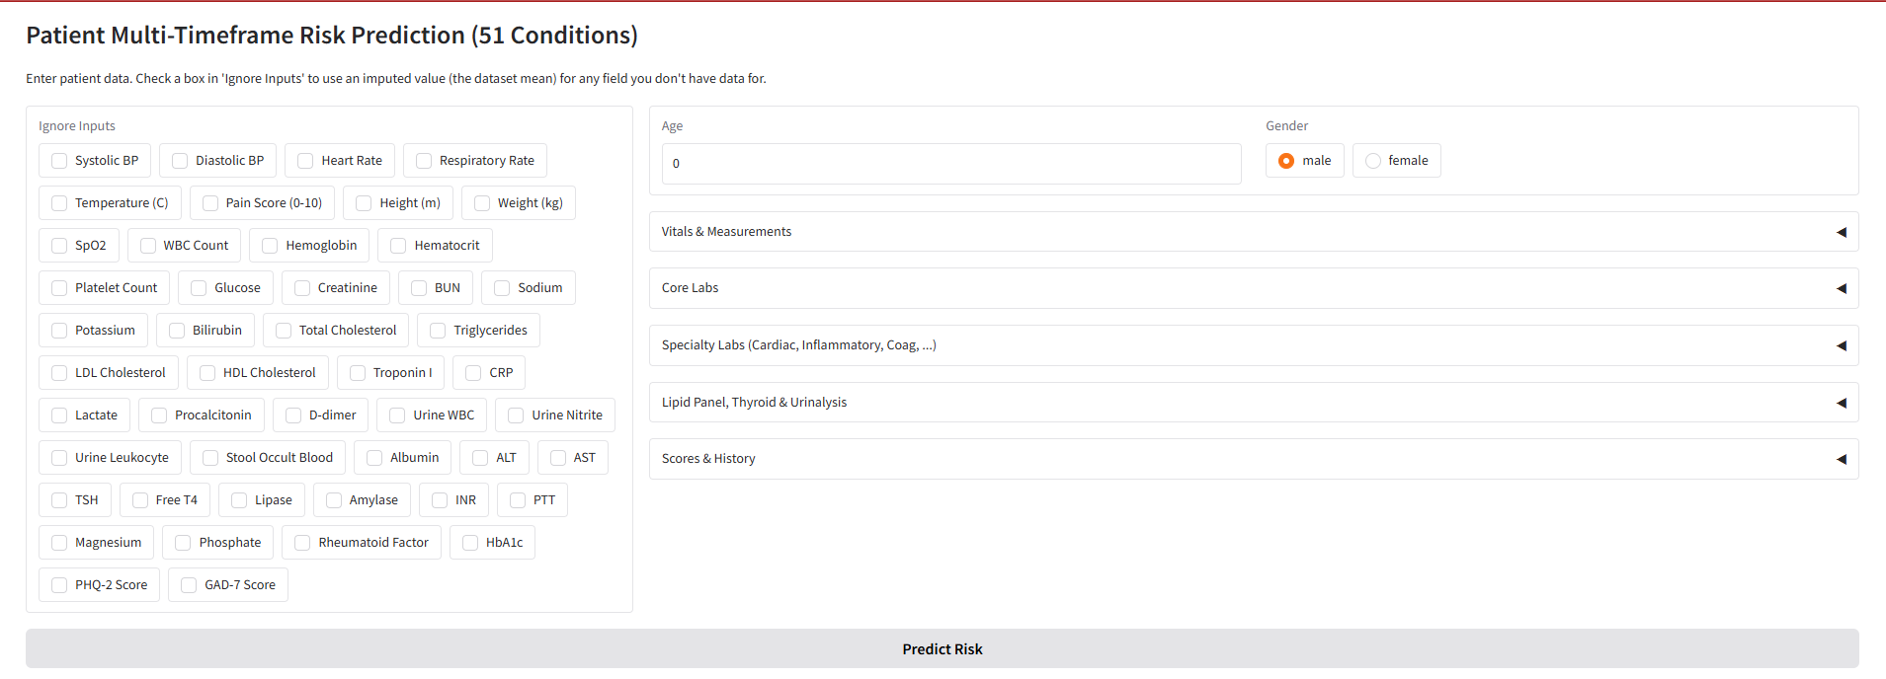

Slide 14
Challenges Faced
Initially, we faced the issue that the AI models were not learning but simply overfitting or making random guesses. We fixed this by balancing class weights and using auc as a metric.
Also faced the issue that sensor readings were extremely inconsistent and inaccurate. Fixed by reading sensor documentation and rigorous calibration.
The 10M+ row dataset was for the EHR modality was too big to fit in RAM. We fixed this by using a streaming data_generator and tf.data.Dataset. This feeds the model small batches (like BATCH_SIZE=8) directly from the hard drive without ever loading the whole dataset.

Slide 15
Future Scope
Implement a third modality for the AI model which uses a combination of accelerometer data and a gesture recognition system with the data from the ESP-32 cam. This will allow for patient monitoring in hospital wards / rooms
Collect more data
Continue to improve AI model to be more accurate and increase the scope to detect more symptoms.
Make the prototype medical bracelet more robust and reliable.
Deploy the AI model on a raspberry pie

